Slide 1
Novel ADCS for CubeSats
Big Changes in Small Satellites
Robotic Exploration Lab
5/13/2019

Slide 2
Contents
What are CubeSats?
Why do we need a new attitude control system?
What could we do with it?
Magnetorquer-only attitude control

Slide 3
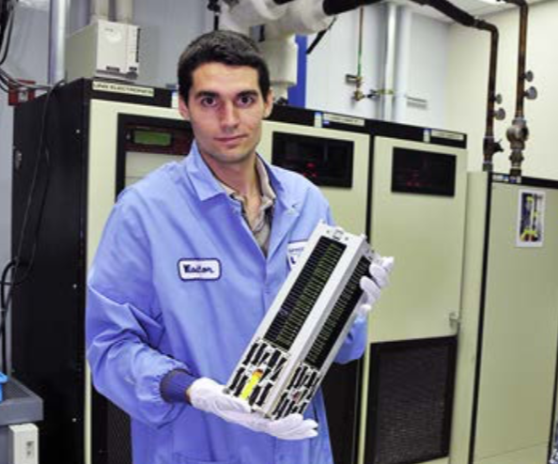
CubeSats
Invented in 1999
Standardized units (1U, 3U, etc.)
Academic, Commercial, Government, International

Slide 4
CubeSats ADCS
Poor sensors (IMU, gryo, mag)
MOI scaling
Stringent gov’t requirements
Expensive
Busek BET-100
CubeSatShop
EnduroSat
Planet Doves

Slide 5
CubeSat Applications
Scientific missions
Astronomy
Inferometry
Interplentary
Government Missions
SATCOM
Earth observation
Commercial Missions
Inter-satellite links
Planet Imagery

Slide 6
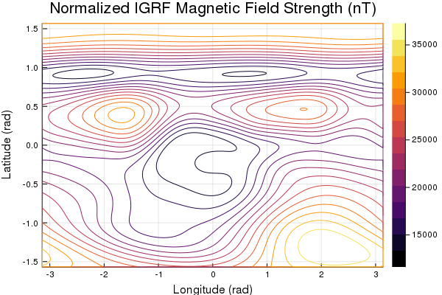
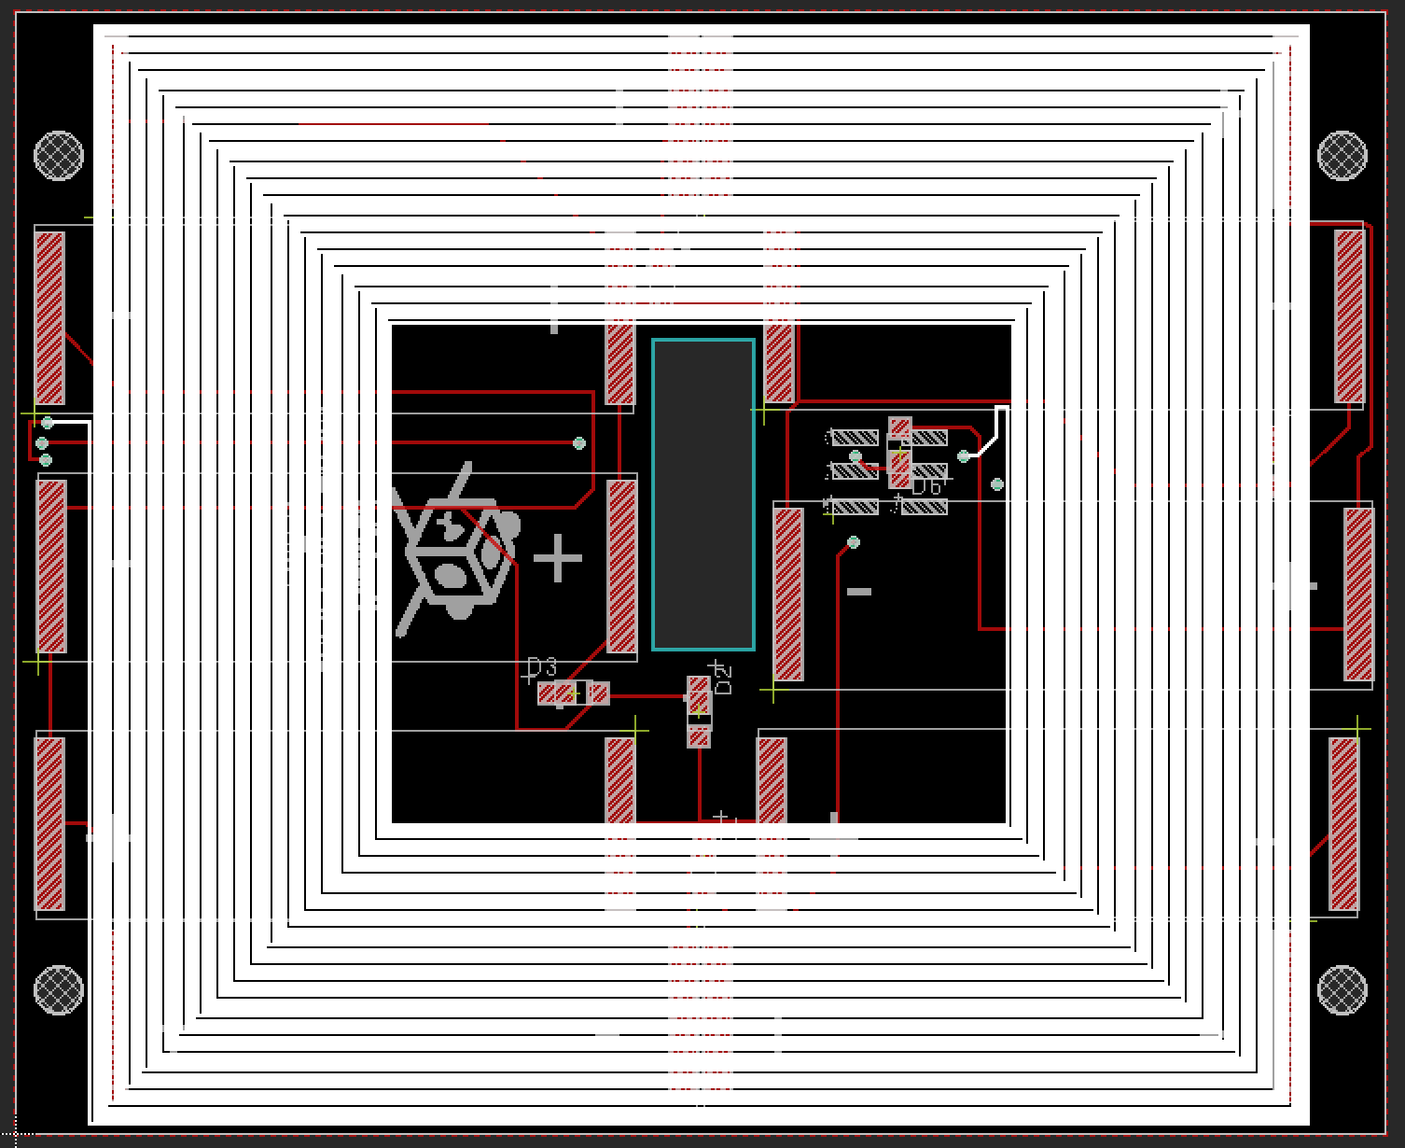
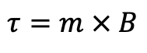
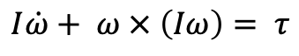
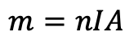
Magnetorquer-only ADCS
Detumbling
IGRF magnetic field model
Trajectory optimization
Combined with other methods – complete attitude control!
$$I\dot{ω}+ ω × \left(Iω\right)= τ$$
$$τ=m × B$$
$$m=nIA$$
Solar Panel Magnetorquer
Magnetic Field
Notes:
Can only not control along track, which doesn’t really matter
Equatorial tracking of ground station hard maybe impossible

Slide 7
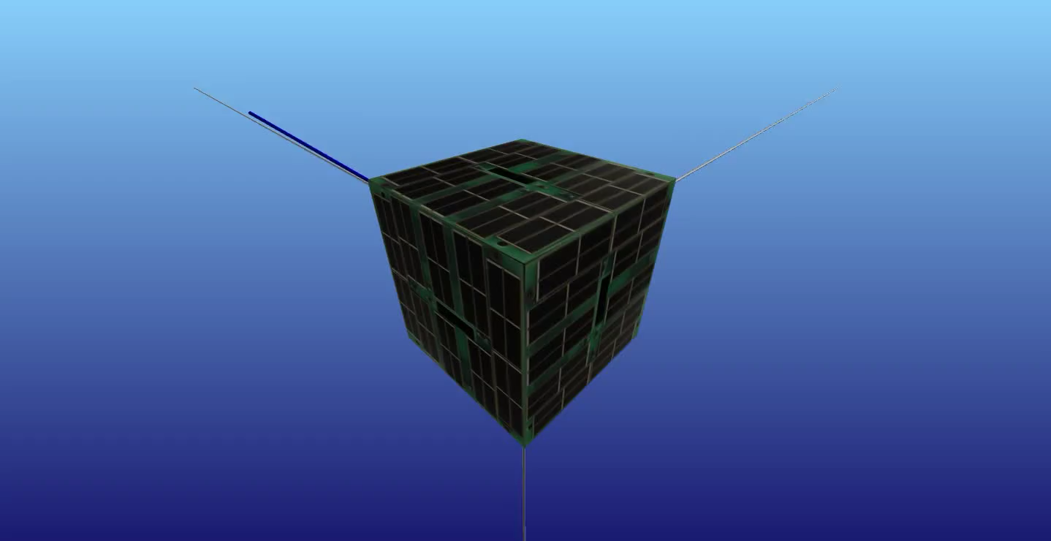

Slide 8
Attitude Determination and Control Systems (ADCS)
Required for almost any space mission
Pointing accuracy
Slew rate
Jitter
SWaP
Passive vs. Active
Multitude of methods
Gravity Gradient
Spin Stabilization
Reaction Wheels
Control Moment Gyros
Thrusters
HS-376
Explorer 49
Reaction Wheels
CMGs

